Slide 1
Comprehensive Audit and Analysis for Effective Digital Presence
Presented by Shaik Arshiya Fathima

Slide 2
MMS Solutions
MMS Solutions is a Chennai-based mobile service center specializing in the repair of various smartphone brands since 10 years, including LG, OnePlus, Pixel, iQOO, and Nothing. With over a decade of experience, their highly trained engineers offer a range of services such as touchscreen and LCD repair, power and volume button repair, speaker and microphone repair, camera repair, battery and charging port repair, and water damage restoration. They operate six branches across Chennai: Adyar, Alwarpet, Ramapuram, Egmore, Nungambakkam, and T.Nagar. Their team is expert when it comes to Replacement of old parts & Damaged parts in smartphones. Along with these requirements, they are also doing customizations as per the customer’s choice.

Slide 3
MMS Solutions
Design and User Experience (UX):
Navigation: The website features a straightforward navigation menu, allowing users to access information about services, brands, and branch locations. However, the current design could benefit from a more modern aesthetic to enhance user engagement.​
Content Layout: The homepage provides an overview of services and branch details. Incorporating high-quality images and concise service descriptions could improve readability and user engagement.​
Call-to-Action (CTA): Clear CTAs, such as "Book a Repair" or "Contact Us," are essential for guiding users toward desired actions. Implementing prominent CTA buttons can enhance user interaction.

Slide 4
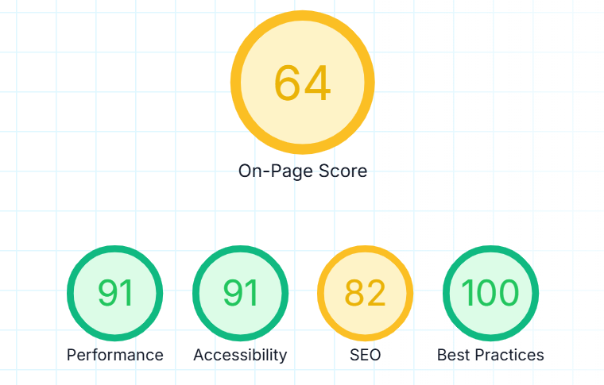
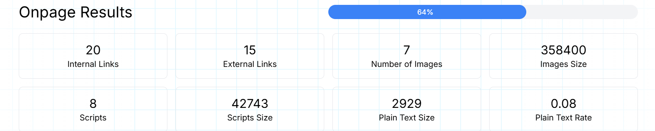
MMS Solutions
SEO Metrics:
Page Load Speed: The site has numerous HTTP requests, which can slow down loading times. Optimizing images, minifying CSS and JavaScript files, and leveraging browser caching can enhance performance.
Mobile Optimization: Ensuring the website is responsive and mobile-friendly is crucial, especially since many users may access the site via smartphones. Implementing media queries and flexible grid layouts can aid in this optimization.
Meta Tags and Descriptions: Crafting unique and descriptive meta titles and descriptions for each page can improve click-through rates from search engine results.

Slide 5
MMS Solutions
Digital Marketing Strategy:
1. Website Optimization & Local SEO:
✅ SEO Optimization:
Implement keyword-rich content focusing on services (e.g., "OnePlus repair in Chennai") to boost search rankings.
Optimize meta tags, descriptions, and header structure for better indexing.
Improve site speed and mobile responsiveness for a seamless user experience.
✅ Local SEO Strategies:
List MMS Solutions on Google My Business and other local directories (Justdial, Sulekha, etc.).
Encourage customer reviews and ratings on Google, Facebook, and industry-specific platforms.
Create location-specific landing pages for each branch (e.g., "Mobile Repair in Adyar").
✅ Technical SEO Enhancements:
Ensure the website has an SSL certificate (HTTPS) for security and credibility.
Optimize alt text for images and improve internal linking to enhance usability.

Slide 6
MMS Solutions
Digital Marketing Strategy:
2. Content Marketing & Social Media Strategy:
✅ Blog & Educational Content:
Publish monthly blog posts on topics like "How to Fix a Water-Damaged Phone" or "Signs Your Phone Battery Needs Replacement."
Develop video tutorials and share on YouTube and Instagram for visual engagement.
✅ Social Media Engagement:
Use Instagram & Facebook to share before-and-after repair stories, customer testimonials, and repair tips.
Leverage short-form content (Reels, TikToks, Stories) to showcase quick fixes or repair hacks.
Engage with customers through polls, Q&A sessions, and giveaways.
✅ Influencer & Affiliate Marketing:
Partner with local tech bloggers, YouTubers, and Instagram influencers to review services.
Offer referral incentives or discounts for word-of-mouth marketing.

Slide 7
MMS Solutions
Digital Marketing Strategy:
3. Paid Advertising & Performance Marketing:
✅ Google Ads Strategy:
Run Search Ads for high-intent keywords like "iPhone screen repair in Chennai."
Use Remarketing Ads to retarget users who visited the website but didn’t book a service.
✅ Facebook & Instagram Ads:
Run location-based ad campaigns to target Chennai residents.
Use carousel ads showcasing repair services with pricing and customer testimonials.
✅ WhatsApp & SMS Marketing:
Implement WhatsApp Business API for quick responses, appointment scheduling, and promotions.
Send personalized SMS offers for repeat customers (e.g., “20% off your next screen repair”).

Slide 8
MMS Solutions
Digital Marketing Strategy:
4. Email Marketing & CRM Strategy
✅ Automated Email Campaigns:
Welcome emails for new customers with service details.
Service reminders (e.g., battery replacement after 1 year).
Special discounts & exclusive offers for loyal customers.
✅ Customer Retention & Loyalty Program:
Introduce a loyalty card for repeat customers (e.g., "5th repair free" or discounts on referrals).
Collect customer feedback through automated follow-up emails after service completion.

Slide 9
MMS Solutions
Digital Marketing Strategy:
5. Integration with Traditional Marketing
✅ QR Code & Offline Promotions:
Add QR codes on business cards, flyers, and in-store posters linking to the website and WhatsApp.
Run offline-to-online contests where customers can participate by sharing experiences on social media.
✅ Partnerships & Offline Events:
Partner with local mobile shops to offer exclusive discounts to their customers.
Host workshops in colleges and tech hubs on mobile maintenance tips.
✅ Radio & Newspaper Ads with Digital CTA:
Add trackable URLs or promo codes in newspaper ads to measure offline-to-online conversions.
Run radio jingles with WhatsApp numbers for easy customer engagement.
https://www.mmsservice.in/

Slide 10
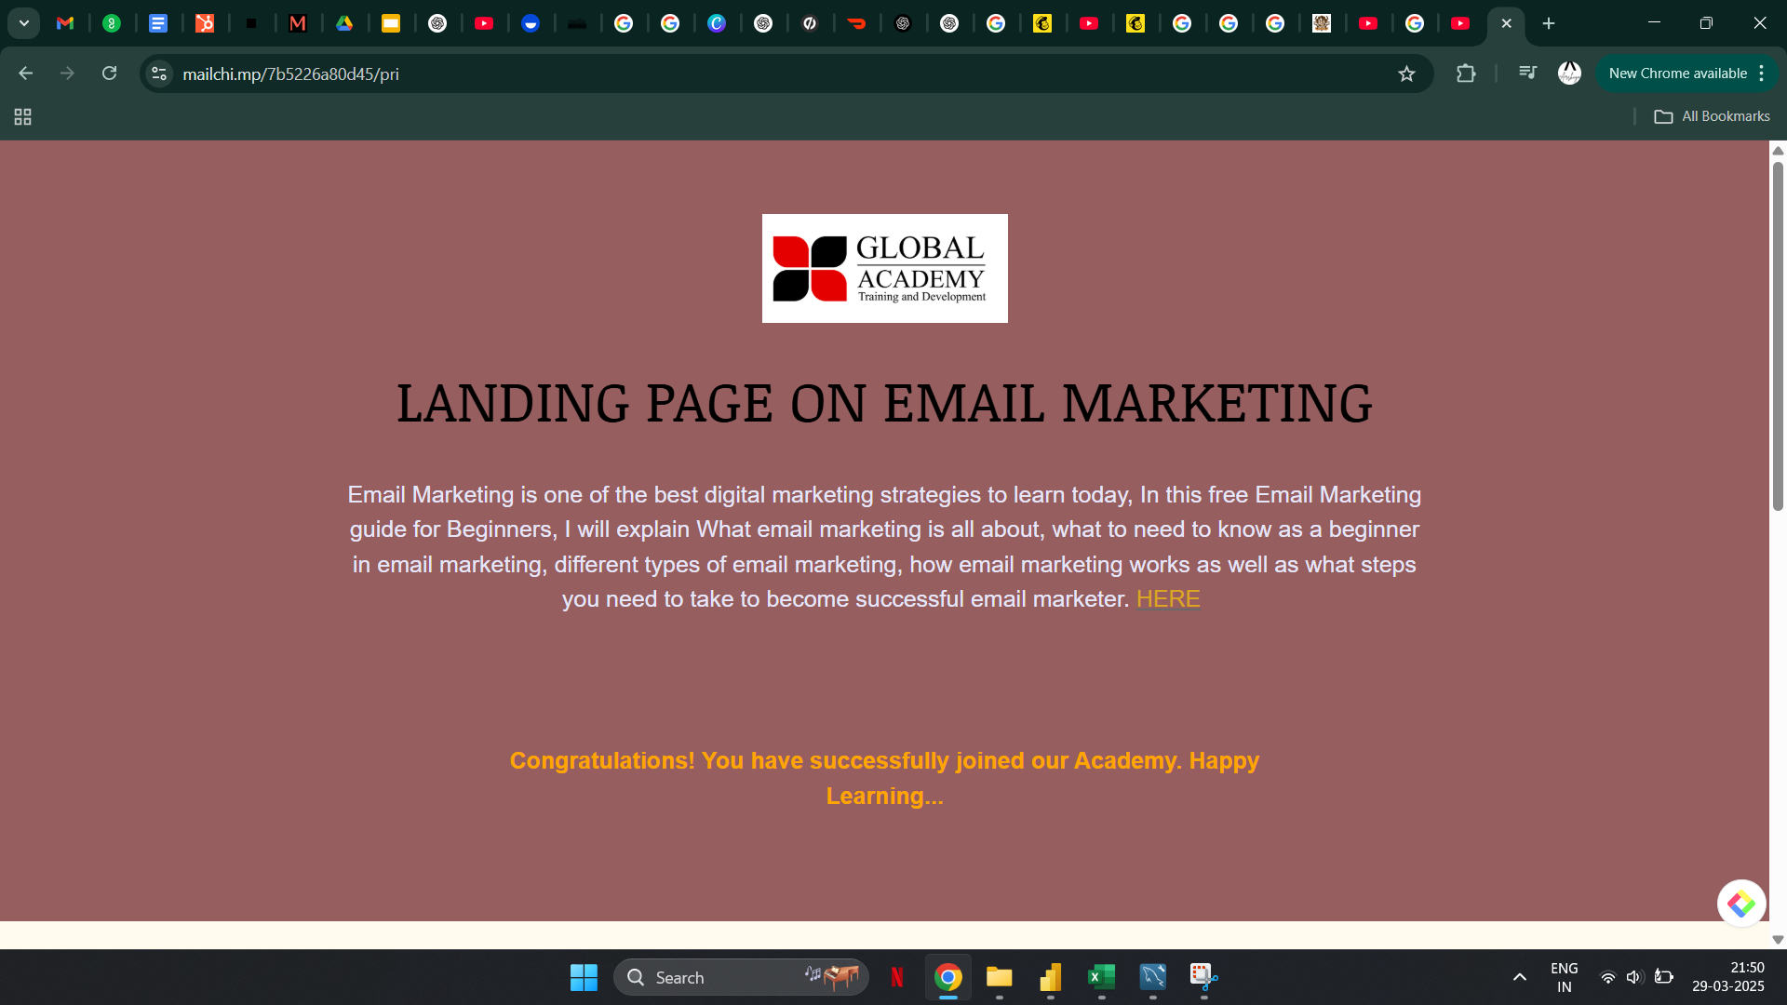
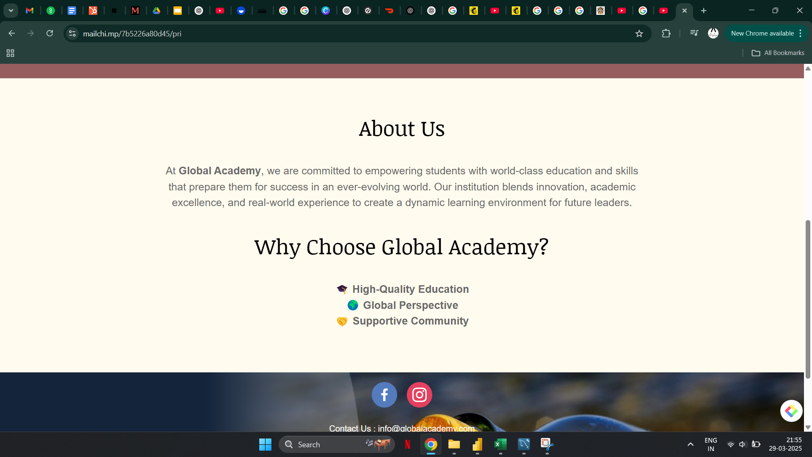
Landing Page
Email Marketing
https://mailchi.mp/7b5226a80d45/pri

